Slide 1
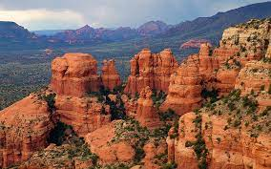



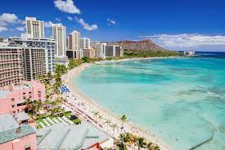
Phone
Tablet
City – Sedona (Dropdown)
880
10 AM
80°F
Sedona
Max Temp:
Min Temp:
Humidity: 1000%
Conditions: Sunny
80°F
10:00AM
Sedona
The city has implemented measures to reduce light pollution, allowing for clear views of the night sky.
Max Temp:
Min Temp:
Humidity: 1000%
Conditions: Sunny
The city has implemented measures to reduce light pollution, allowing for clear views of the night sky.
Sedona is renowned for its breathtaking natural beauty, particularly its red sandstone formations. The city is often referred to as "Red Rock Co
Sedona is renowned for its breathtaking natural beauty, particularly its red sandstone formations. Th

Slide 2
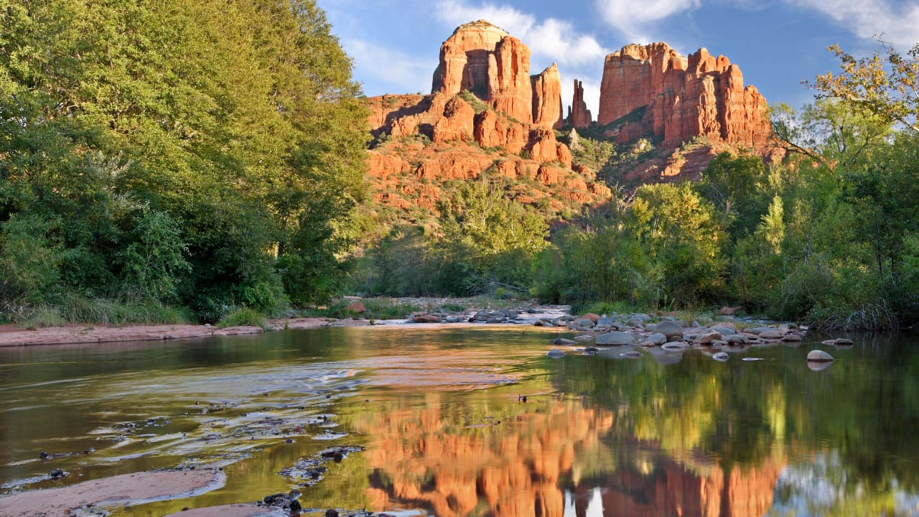
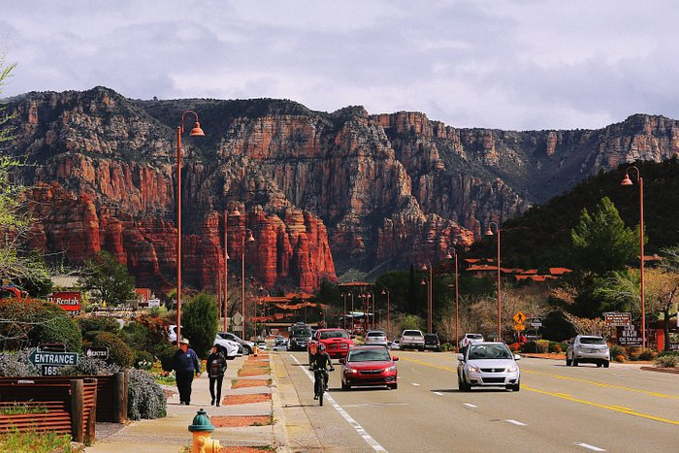
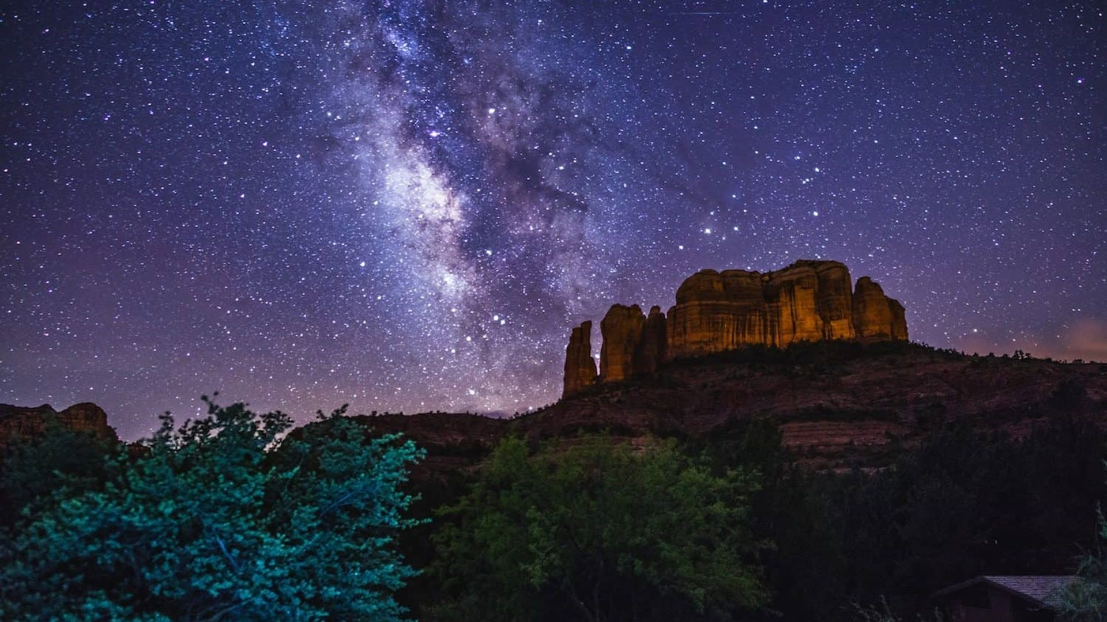
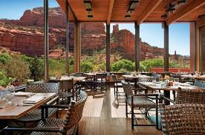
Sedona, AZ
Seattle, WA
Denver, CO
New Orleans, LA
Honolulu, Hi
Sedona
80°F
10:00AM
Max Temp: 123
Min Temp: 123
Humidity: 10000%
Conditions: Sunny
The city has implemented measures to reduce light pollution, allowing for clear views of the night sky.
Sedona is renowned for its breathtaking natural beauty, particularly its red sandstone formations. The city is often referred to as "Red Rock Country"

